Slide 1







Introduction to SKY ERP HRM
Streamline. Automate. Empower
SKY ERP HRM, developed by Everex Infotech, is a comprehensive software solution that centralises and streamlines core HR functions like attendance, leave, payroll, recruitment, performance, and compliance. Its modular, scalable design suits organisations of all sizes. With a user-friendly interface and mobile app, it enables HR teams and employees to access key features anytime. Automation reduces manual work, improves accuracy, and supports faster decisions – enhancing productivity and providing real-time workforce insights.

Slide 2







  The Importance of SKY ERP HRM
A Smarter Way to Manage Your Workforce
SKY ERP HRM centralises and automates key HR functions, helping organisations reduce manual work and increase accuracy. With real-time access to data, mobile functionality, and built-in compliance, it empowers HR teams to operate efficiently and support business growth.
  Set Efficient Core HR Operations
  Improves Accuracy and Compliance
Automate processes like attendance, payroll, & leave management in 1 platform.
Reduces manual errors and ensures statutory compliance with built-in tools.
  Empowers HR and Employees
  Support Scalable and Strategic HR
Provides real-time access to data and self-service options via mobile app.
Enables data-driven decisions and adapts easily to growing organisational needs.
www.everexinfotech.com

Slide 3
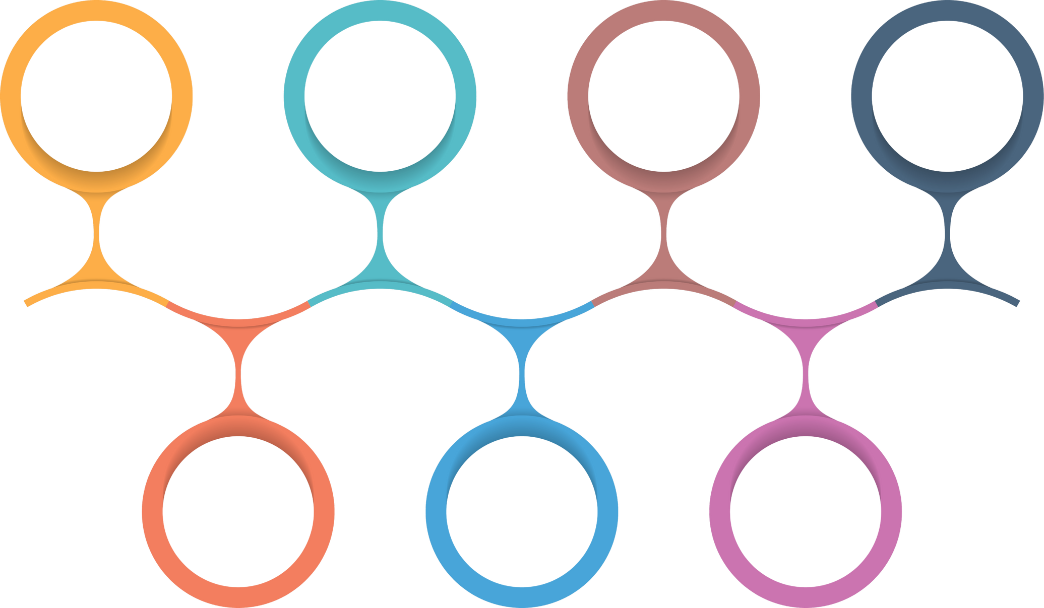
  Core Feature of SKY ERP HRM
Streamline Solution for Every HR
Employee Information Management
Attendance and Leave Management
Appraisal & Performance Management
Payroll Management
Internal Recruitment Management
External Recruitment Management
Mobile Application
www.everexinfotech.com

Slide 4
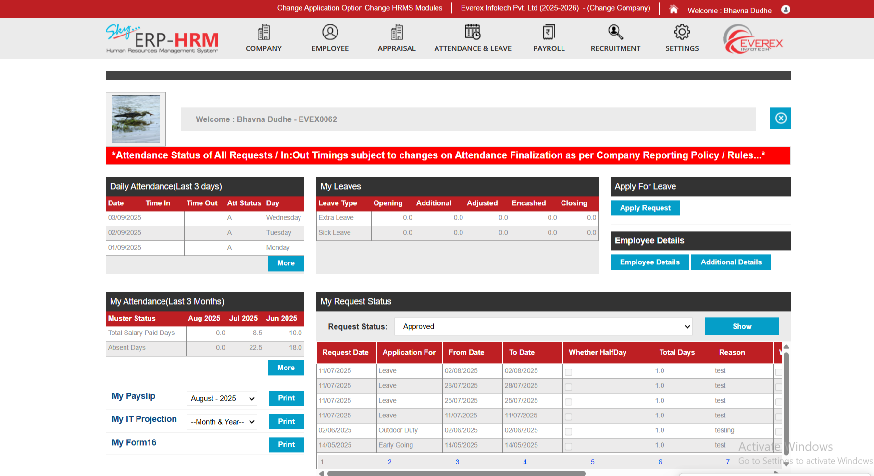
  Dashboard
www.everexinfotech.com

Slide 5
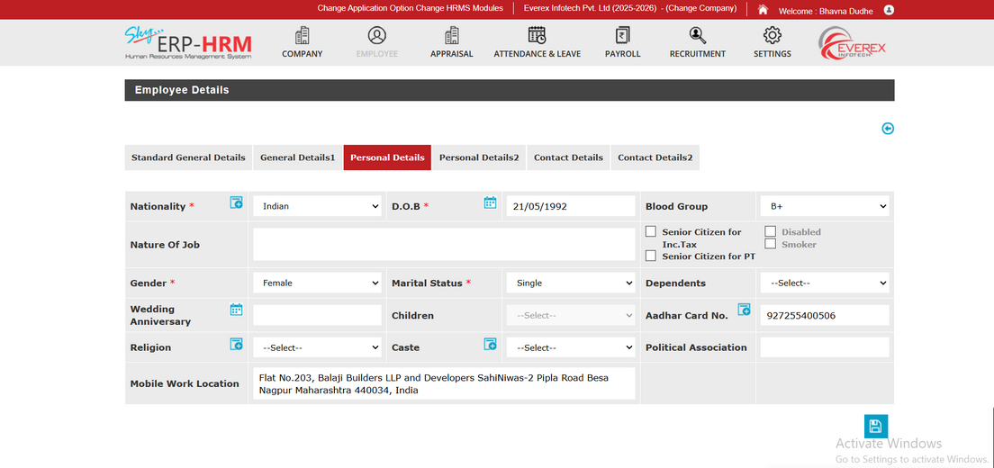
  Employee Information Management
QUICK SEARCH AND MANAGE EMPLOYEE RECORDS
ASSIGN AND TRACK ASSETS PER EMPLOYEE
MAINTAIN A CENTRALISED EMPLOYEE DATA SYSTEM
PLAN AND ASSIGN SHIFTS ACROSS BRANCHES
HANDLE TRANSFERS BETWEEN MULTIPLE LOCATIONS EASILY
VIEW HIERARCHY BY ROLE AND DEPARTMENT
www.everexinfotech.com

Slide 6
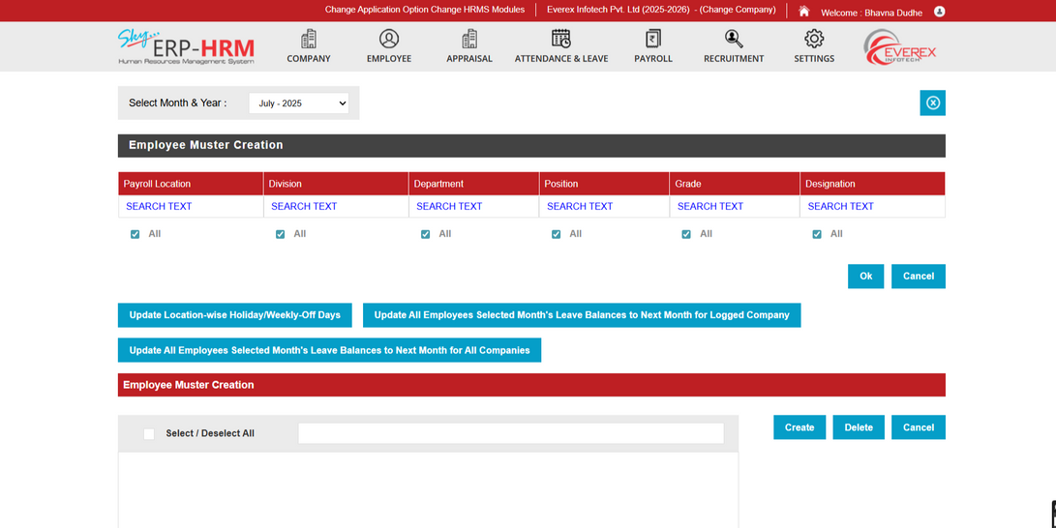
  Attendance and Leave Management
CUSTOMIZE LEAVE TYPE, POLICIES AND RULES
APPLY AND APPROVE LEAVE WITH EASE
TRACK ATTENDANCE VIA BIOMETRIC OR MOBILE
AUTOMATED EMAIL TO HODS AND HR FOR APPROVAL
AUTO-GENERATE MUSTER ROLLS FOR PAYROLL
DOWNLOAD DETAILED LEAVES AND ATTENDANCE REPORTS.
TRACK FIELDS AND OD TIME WITH GPS
REAL-TIME ALERTS TRIGGERED WHEN EMPLOYEES MISS BIOMETRIC ATTENDANCE PUNCHES.
www.everexinfotech.com

Slide 7
  Payroll Management
DEFINE SALARY HEADS LIKE HRA, ALLOWANCE AND DEDUCTIONS
TRACK ARREARS AND BONUSES ACROSS PAYROLL CYCLES
CREATE PAY STRUCTURE FOR ROLES AND DEPARTMENT
DOWNLOAD SALARY SHEETS AND EMPLOYEE SALARY CARDS
ADD MONTHLY INCENTIVES, BONUSES AND DEDUCTIONS EASILY
MANAGE EMPLOYEE LOANS AND AUTO-DEDUCT EMIS
AUTOMATE PAYROLL USING ATTENDANCE AND LEAVE DATA
RECORD DEBIT NOTES WITH SUPPORTING DOCUMENTATION
AUTO-CALCULATE TDS BASED ON EMPLOYEE DEDUCTIONS
ENSURE STATUTORY COMPLIANCE AND LABOUR LAW WITH AUTOMATION
GENERATE PAYSLIPS WITH EARNING AND DEDUCTIONS BREAKDOWNS
www.everexinfotech.com

Slide 8

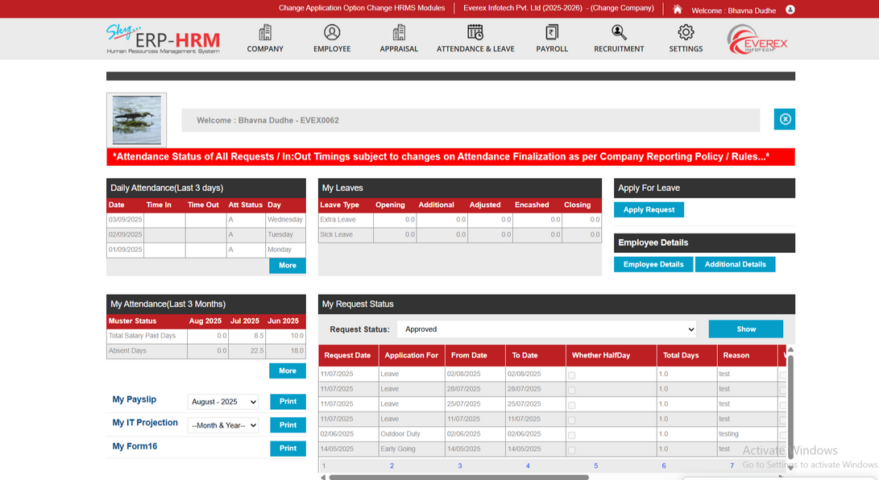

Enhance your SKY ERP HRM experience with powerful add-on modules tailored to your needs.
These premium features are available at an additional cost to maximise functionality and flexibility.
www.everexinfotech.com

Slide 9
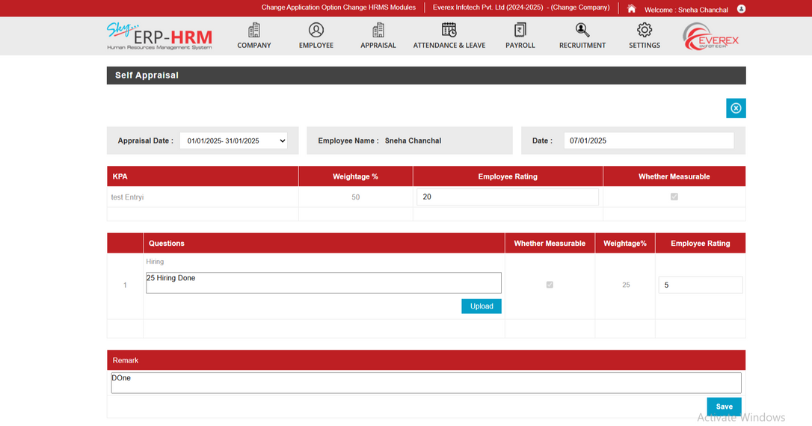
  Appraisal & Performance Management
DEFINE AND CUSTOMIZATION KPA & KRA FOR EACH DEPARTMENT
ASSIGN SPECIFIC KRAS TO EMPLOYEES WITH METRICS
CREATE APPRAISAL QUESTIONS TAILORED TO YOUR FRAMEWORK
DEFINE AND ASSIGN TASKS WITHIN PERFORMANCE REVIEWS
TASK PROGRESS OF TASKS LINKED TO APPRAISAL
EVALUATE EMPLOYEES ON DEADLINE AND TASK PRIORITY
ENABLE EMPLOYEE TO SELF-ACCESS THEIR PERFORMANCE
ALLOWS HODS TO REVIEW EMPLOYEE DELIVERABLES
HR CONSOLIDATE DATA FOR FINAL APPRAISAL DECISION
www.everexinfotech.com

Slide 10
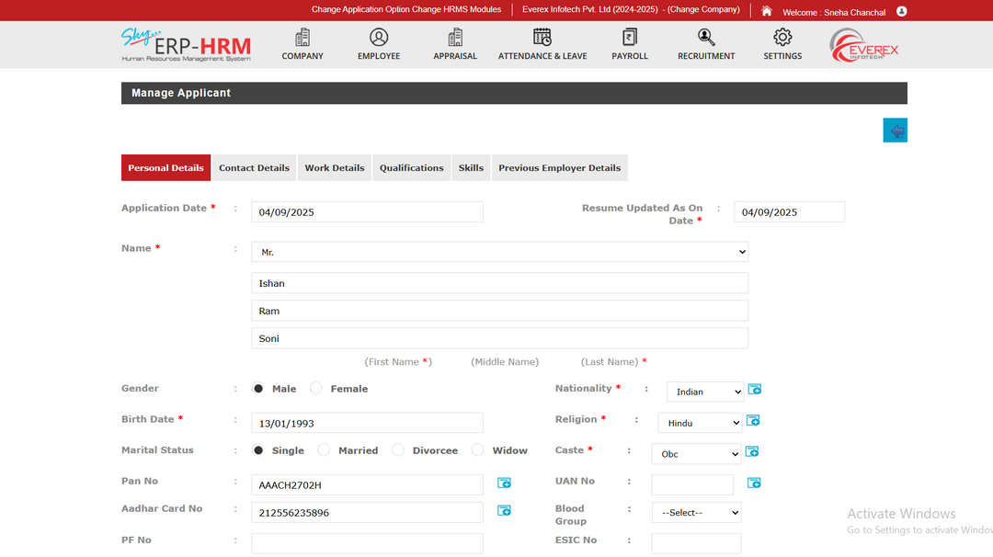
  Internal Recruitment Management
MAP INTERNAL ROLES, SKILLS, AND QUALIFICATION EFFICIENTLY
CREATE VACANCIES WITH ROLES, PERKS, AND RESPONSIBILITY
ASSIGN AND TRACK RECRUITMENT TASKS AND ACTIVITIES DAILY
CONFIGURE INTERVIEWS, QUESTIONS AND EVALUATION ROUNDS EASILY
ASSIGN COORDINATORS FOR INTERVIEW SCHEDULING AND FOLLOW-UPS
MANAGE APPLICANT DETAILS, HISTORY, AND VERIFICATION PROCESSES
AUTHORISE AND VERIFY CANDIDATES THROUGH INTERNAL CONTROLS
ASSIGN VACANCIES TO HR TEAM MEMBERS
www.everexinfotech.com

Slide 11
  External Recruitment Management
A centralised platform that enables recruitment consultants and agencies to manage vacancies multiple organisations. It streamlines candidate submissions, communication, and onboarding processes for improved efficiency and collaboration.
DEFINE JOB ROLES, SKILLS, AND HIRING CRITERIA
STORE AND REVIEW DETAILED APPLICANT INFORMATION RECORDS
MANAGE CLIENTS, INDUSTRIES, BRANCHES AND CONTRACTS
TRACK RECRUITMENT STATUS, PLACEMENTS, AND BILLING UPDATES
ASSIGN EXTERNAL CONSULTANTS AND RECRUITMENT COORDINATORS
PROVIDE INVOICE TO MULTIPLE ORGANISATIONS THROUGH THE SYSTEM
MAP HIRING REGIONS AND ASSOCIATED PERKS EFFICIENTLY
UPDATE BILLING AND TAXES WITH EASE
HANDLE APPLICANT INTAKE, SCREENING, AND INTERVIEW ROUNDS
www.everexinfotech.com

Slide 12
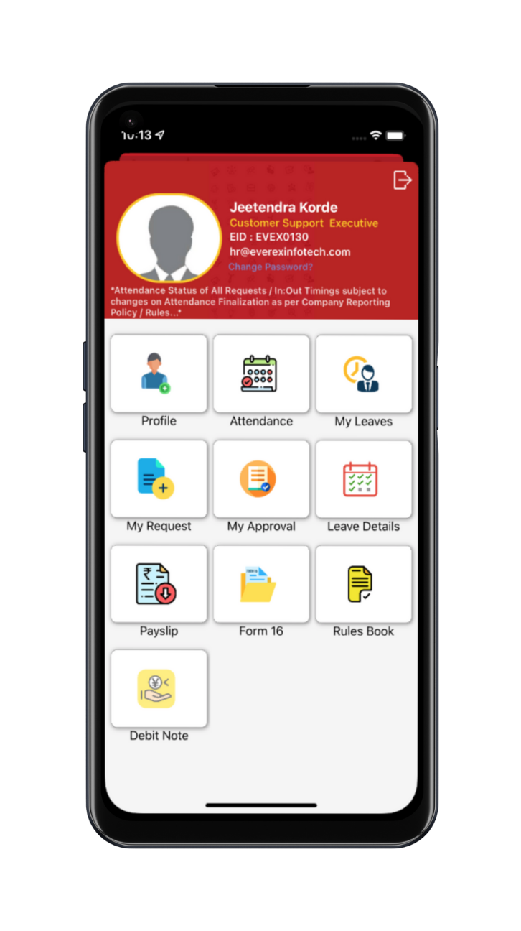
  Mobile Application
VIEW AND MANAGE PERSONAL PROFILE INFORMATION EASILY
MARK ATTENDANCE, VIEW LOGS, AND TRACK HISTORY
APPLY FOR LEAVE AND CHECK REQUEST STATUS
GEOLOCATION TO TRACK THE LOCATION OF EMPLOYEES
SUBMIT AND TRACK ALL HR- RELATED SERVICE REQUESTS
MANAGERS CAN APPROVE ATTENDANCE, LEAVE, AND MORE
DOWNLOAD PAYSLIPS, FORM 16, AND DEBIT NOTES
ACCESS HR POLICIES AND RULE BOOK ANYTIME
SET UP AUTOMATED REMINDERS FOR MISSED BIOMETRIC PUNCH-INS.
www.everexinfotech.com

Slide 13
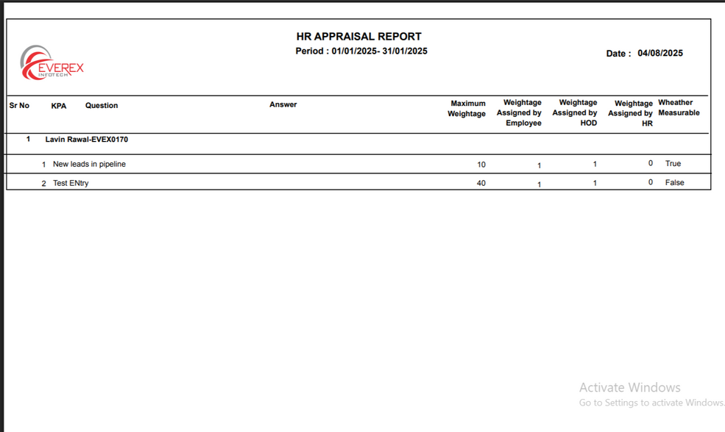
  Reporting and Analytics
GENERATE EMPLOYEE REPORTS FOR BIRTHDAYS AND ASSETS
TRACK DAILY ATTENDANCE, HOLIDAYS, AND MUSTER ROLLS.
VIEW LEAVE BALANCES, OD, AND ENCASHMENT SUMMARIES
ACCESS PAYROLL DATA, PAYS LIPS, AND STATUTORY FORMS
MONITOR RECRUITMENT STATUS, INTERVIEWS, AND HIRED CANDIDATES
REVIEW APPRAISAL RESULTS ACROSS EMPLOYEE AND DEPARTMENT LEVELS
EXPORT CUSTOM REPORTS FILTERED BY DATE OR DEPARTMENT
AUTOMATED EMAIL/SMS FOR BIRTHDAY AND ANNIVERSARIES
www.everexinfotech.com

Slide 14
  Automation in SKY ERP HRM
Key Highlights to Streamline and Automate
STREAMLINED HR PROCESSES
AUTOMATE ROUTINE TASKS LIKE ATTENDANCE, LEAVES, AND PAYROLLS.
REDUCES MANUAL ERRORS
AUTO-CALCULATING SALARIES, TAXES, AND BENEFITS.
IMPROVES EFFICIENCY
AUTOMATING DATA ENTRY, DOCUMENT GENERATION, AND REPORT CREATION.
ENHANCES RECRUITMENT
AUTOMATES JOB POSTING, CANDIDATE SCREENING, AND INTERVIEW SCHEDULING.
ONBOARDING AUTOMATION
AUTOMATES WELCOME EMAILS, DOCUMENT COLLECTION, AND TRAINING SCHEDULES.
www.everexinfotech.com

Slide 15
SELF-SERVICE PORTALS
AUTOMATE EMPLOYEES TO UPDATE INFO, APPLY FOR LEAVE, AND DOWNLOAD PAYSLIPS.
COMPLIANCE MANAGEMENT
AUTOMATE REGULATORY CHANGES AND TIMELY UPDATES TO POLICIES AND DOCUMENTATION.
PERFORMANCE TRACKING
AUTOMATES GOAL SETTING, FEEDBACK COLLECTION, AND APPRAISAL WORKFLOWS.
ALERTS & NOTIFICATIONS
AUTOMATES REMINDERS FOR IMPORTANT HR ACTIVITIES LIKE POLICY UPDATES.
ANALYTICS & REPORTING
AUTO-GENERATES DASHBOARDS FOR WORKFORCE INSIGHTS AND STRATEGIC DECISIONS.
www.everexinfotech.com

Slide 16

  Common Challenges Faced by HR
Understanding the limitations of Traditional HR Processes
TIME-CONSUMING PROCESSES
MANUAL ENTRY AND PAPERWORK TAKES TIME AND REDUCES EFFICIENCY.
HUMAN ERROR
MISTAKE IN DATA ENTRY, MISFILING DOCUMENTS, OR MISCALCULATING PAYROLL.
LACK REAL-TIME DATA
REAL-TIME UPDATES MISSING, MAKE IT HARD TO TRACK ATTENDANCE, PERFORMANCE.
LIMITED REPORTING
LACKS BUILT-IN REPORTING TOOLS, HARD TO TRACK HR METRICS LIKE ABSENTEEISM.
COMPLIANCE RISK
FAILURE TO MAINTAIN RECORDS AND RESPOND TO REGULATORY AUDITS.
CONFIDENTIALITY ISSUES
PHYSICAL DOCS. ARE EASIER TO ACCESS OR LOSE, PUTTING EMPLOYEE INFORMATION AT RISK.
SCALABILITY PROBLEMS
AS ORGANIZATIONS GROW, MANUAL SYSTEM BECOME UNMANAGEABLE AND INEFFICIENT.
www.everexinfotech.com

Slide 17
  Conquer HR Chaos with SKY ERP HRM
Solution to Common Manual HR Challenges
TIME-CONSUMING PROCESSES
AUTOMATES TASKS LIKE PAYROLL, LEAVE APPROVALS, AND ONBOARDING VIA DIGITAL WORKFLOWS.
HUMAN ERROR
REDUCES DATA ENTRY ERRORS THROUGH VALIDATION, AUTOMATION, AND INTEGRATION.
LACK REAL-TIME DATA
PROVIDES DEAL TIME DASHBOARD FOR ATTENDANCE, PERFORMANCE, AND UPDATES.
LIMITED REPORTING
BUILT-IN ANALYTICS TOOLS OFFER INSIGHTS INTO HR METRICS FOR BETTER DECISION MAKING.
COMPLIANCE RISK
AUTOMATED COMPLIANCE ALERTS, AUDIT TRAILS AND DOCUMENTATION IMPROVE READINESS.
CONFIDENTIALITY ISSUES
ROLE-BASED ACCESS AND DATA ENCRYPTION PROTECTS SENSITIVE EMPLOYEE DATA.
SCALABILITY PROBLEMS
CLOUD-BASED ARCHITECTURE SCALES WITH BUSINESS GROWTH EFFORTLESSLY.
www.everexinfotech.com

Slide 18
Informed Decision Making
1
  Cost Optimization
  2
  Talent Management at Scale
  3
  Compliance & Risk Mitigation
Strategic Benefits of SKY ERP HRM
  4
  Enhanced Employee Productivity
  5
Empowering Leader with Data-Driven HR Efficiency
  Scalable Workforce Strategy
  6
  Data Security & Centralization
  7
  Employee Document Management
  8
  Strategic Reports and Analytics
  9
www.everexinfotech.com

Slide 19






Contact us
26, Champa Gully, M. J. Market Lane, Mumbai - 400002, INDIA
info@everexinfotech.com
+91-22-4226 4444
+91-81-0434 5257
www.everexinfotech.com

